Slide 1
Understanding Indian customers car buying behavior
By - Anushka Poddaturi

Slide 2
Agenda
Introduction
Pre – Processing
Data Mining Analysis
Results
Conclusion
Data Description

Slide 3
Introduction
The project is to understand the buying behavior of Indian customers while investing in cars.
They are attributes such as price, make, salary etc. The project is to understand what customers’ take in account while buying a car.
The objective is to increase car sales in dealer outlets rather than customers’ relying on online websites.

Slide 4
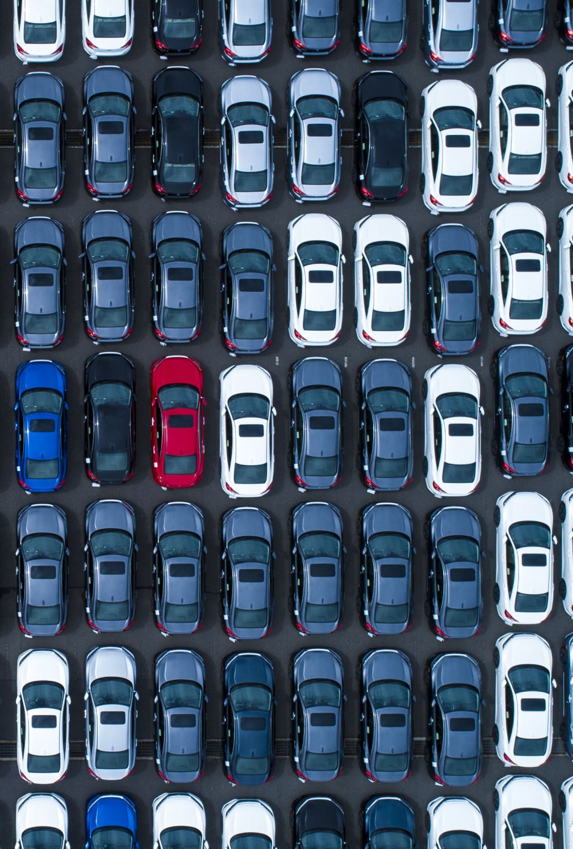
Data Description
The data describes the factors and variables considered by customers’ while buying a car such as price, make, salary etc.
It shows data of around 100 customers with different age groups, professions and the model of the cars.
It also takes into consideration the usage in a particular household by including factors such as no of dependents.

Slide 5
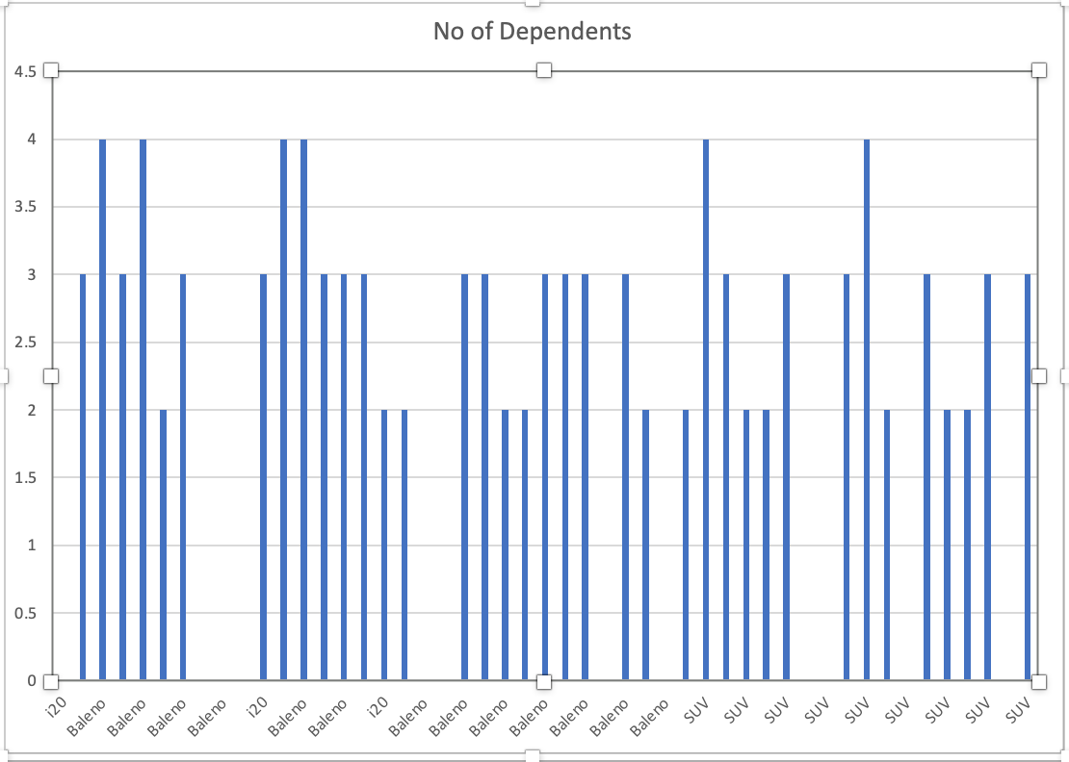
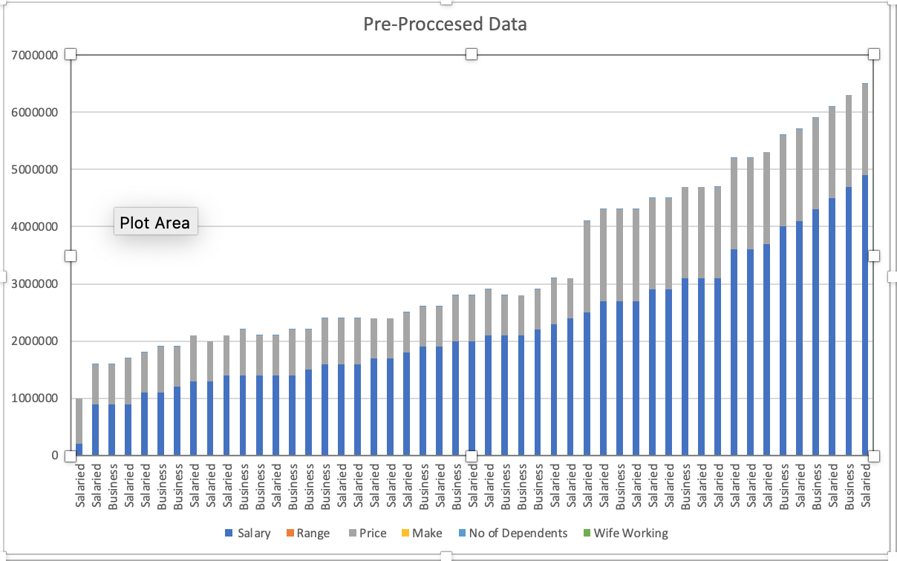
Pre - Processing
Manually categorized the salary into high, medium and low.
Removed blank spaces, punctuations, partial data and unnecessary words which were irrelevant.
We have cleaned the data and selected 3 different cars with price ranges in accordance with salaries.
We have converted the data file into csv and loaded the set into weka by changing it into arff format.

Slide 6

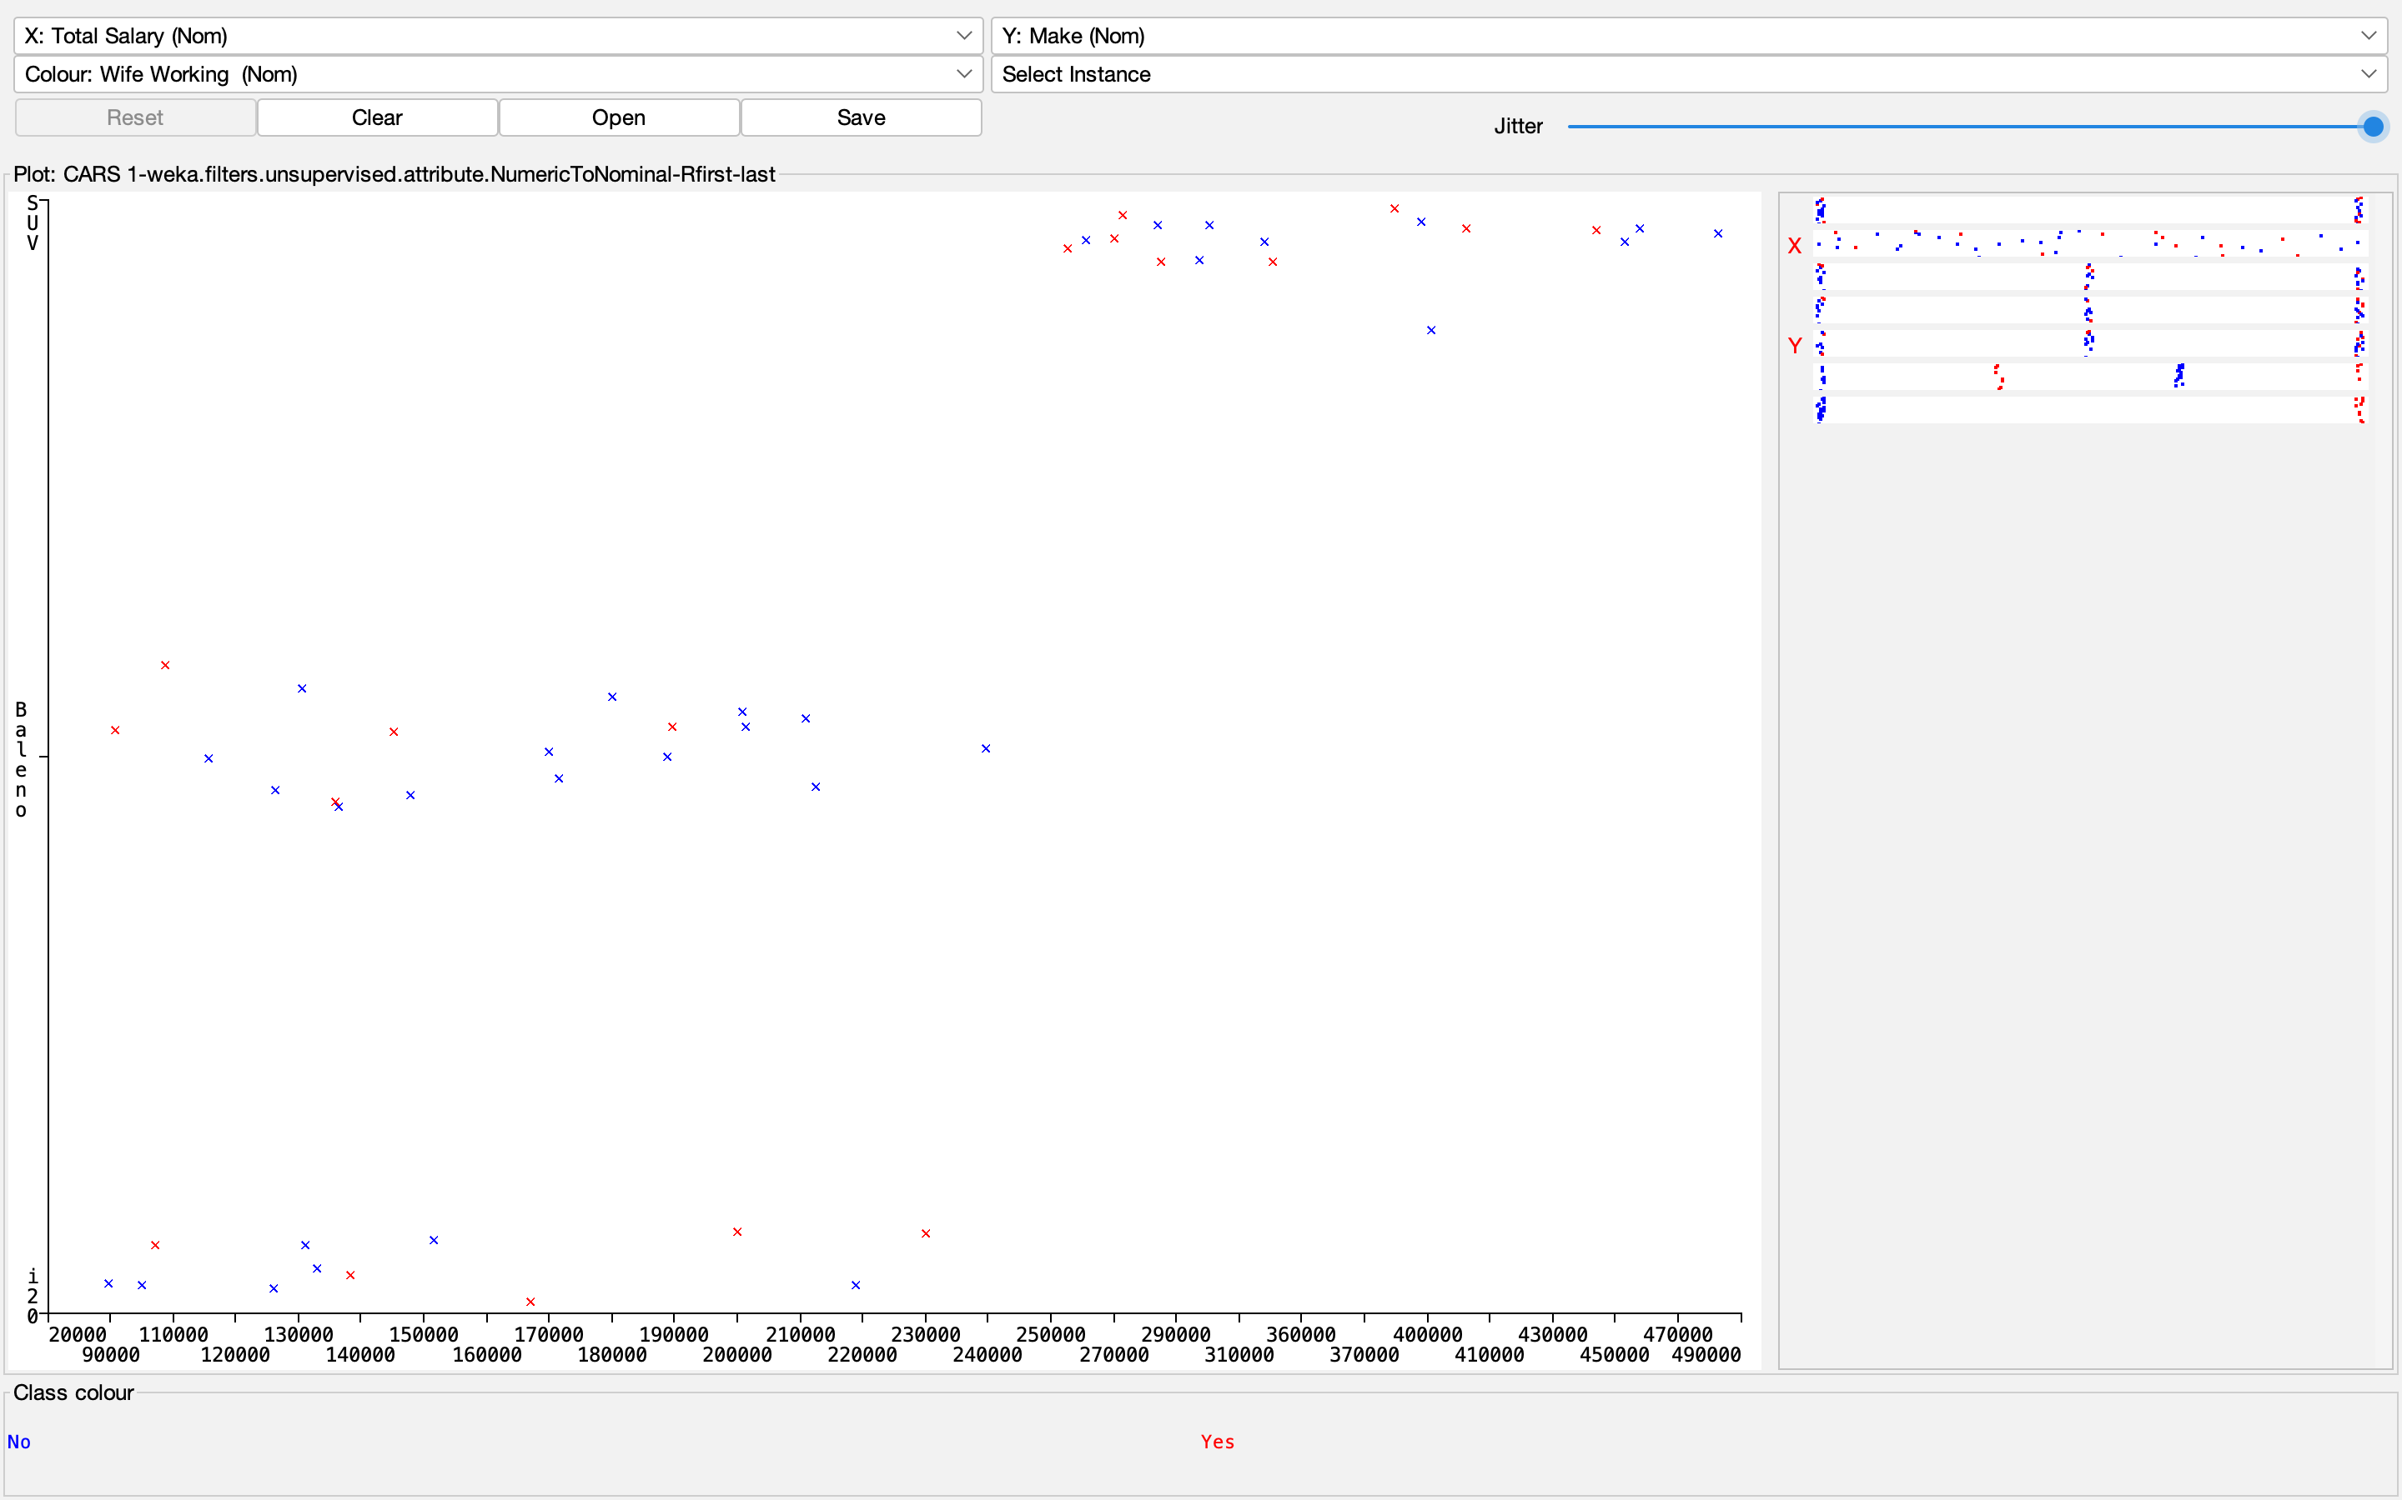
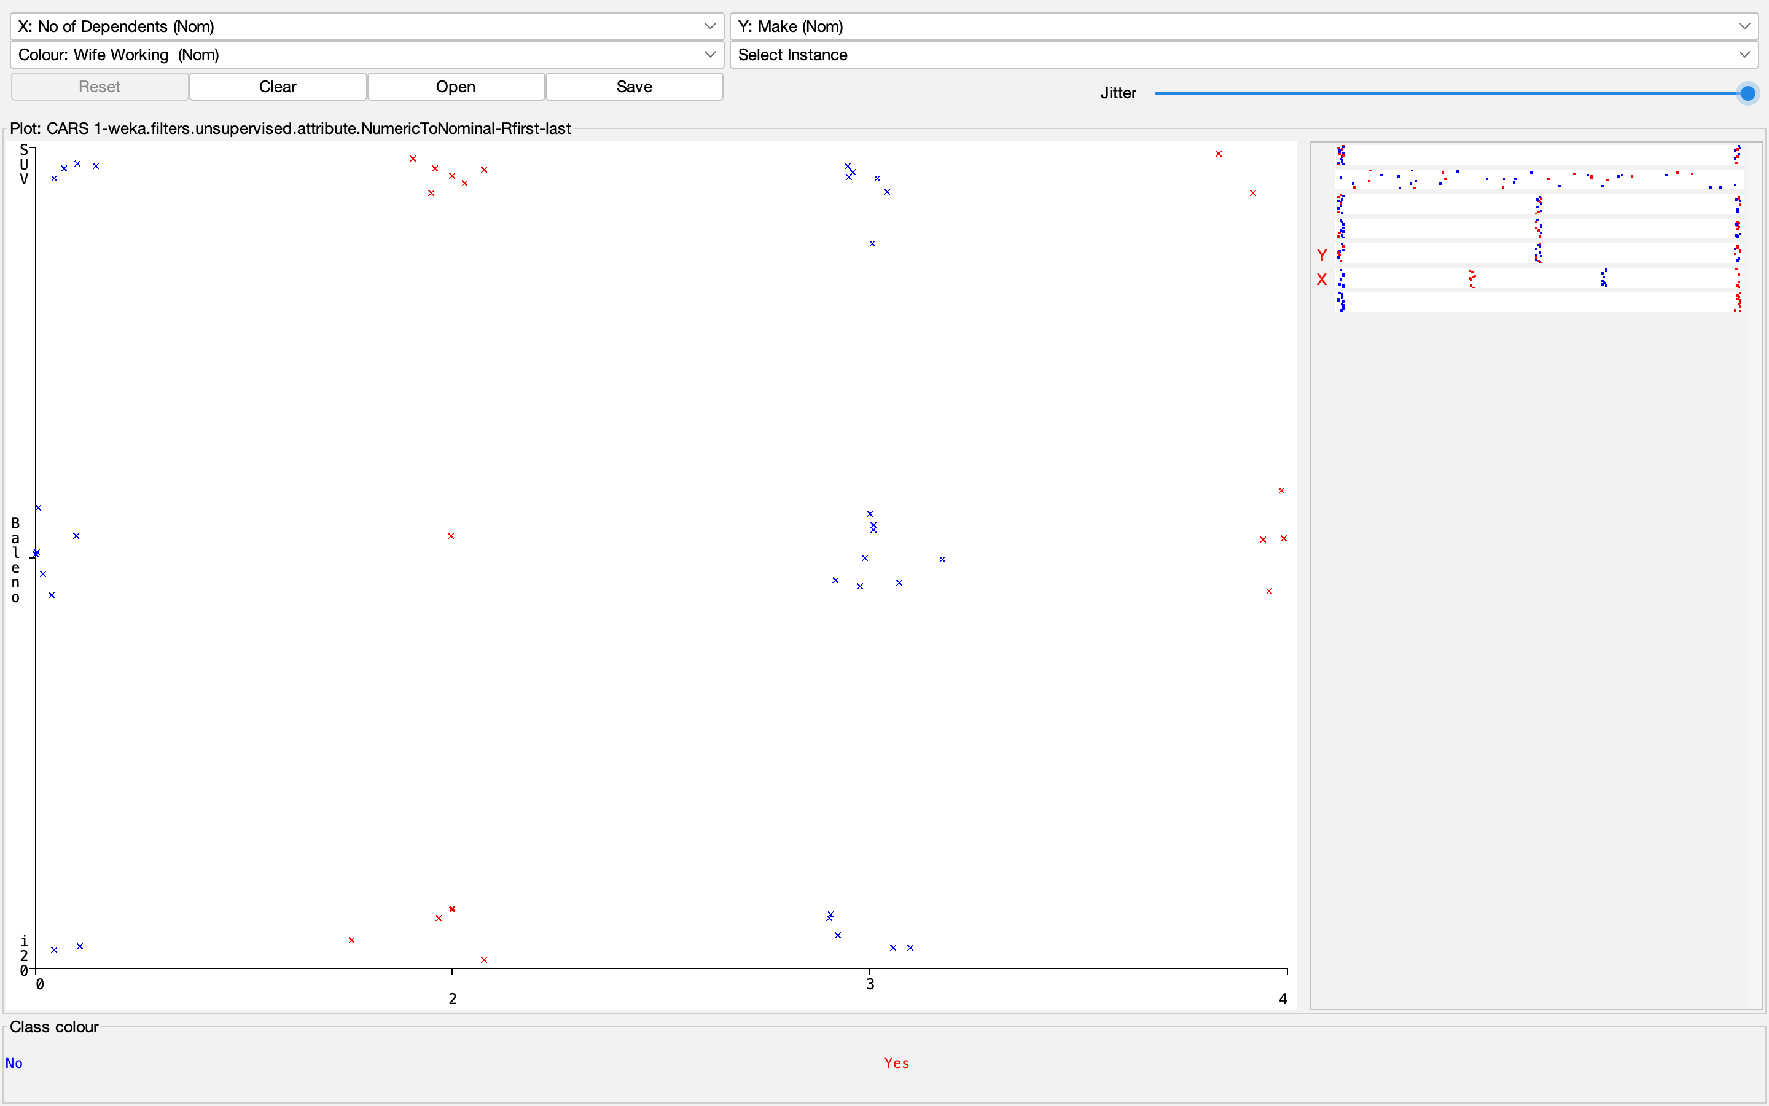
Visualization

Slide 7
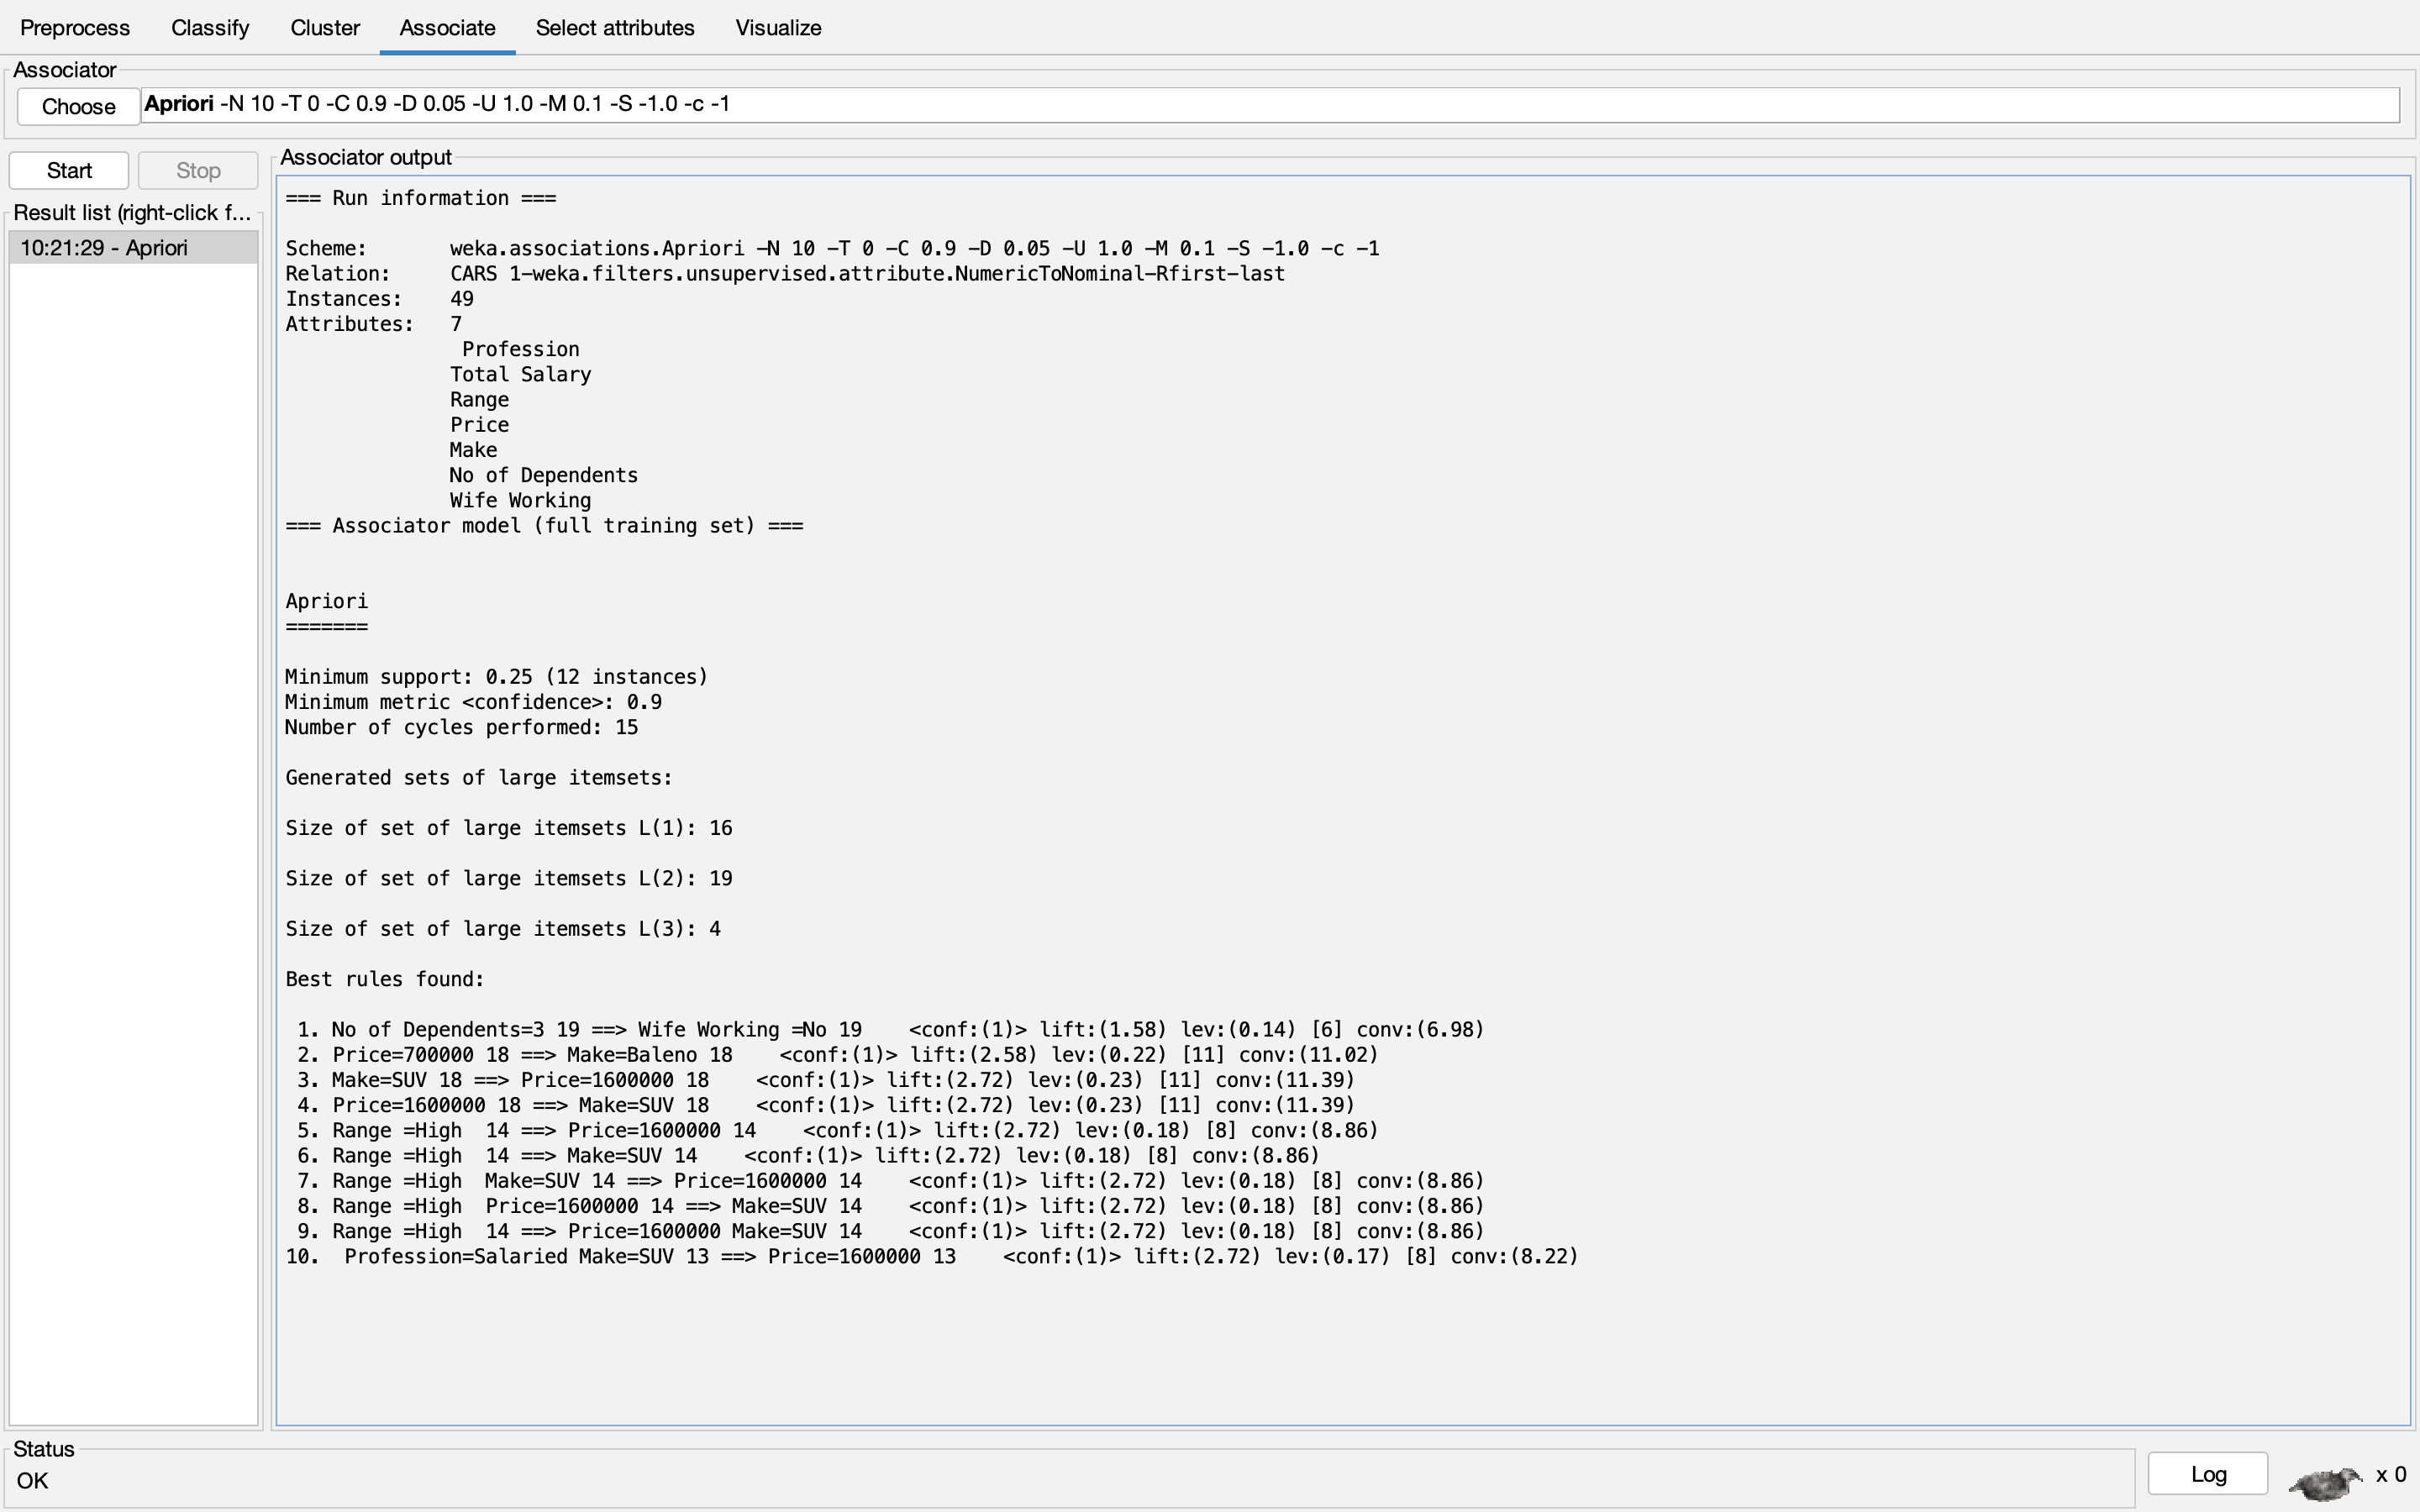
Data Mining Analysis –Association rule mining
We performed the apriori method with default settings and it generated certain rules.
The support being 0.2 and confidence being 0.9
It is seen that most customers’ whose salary range is high, have dependents as 0 and are inclined to buy suv’s.

Slide 8
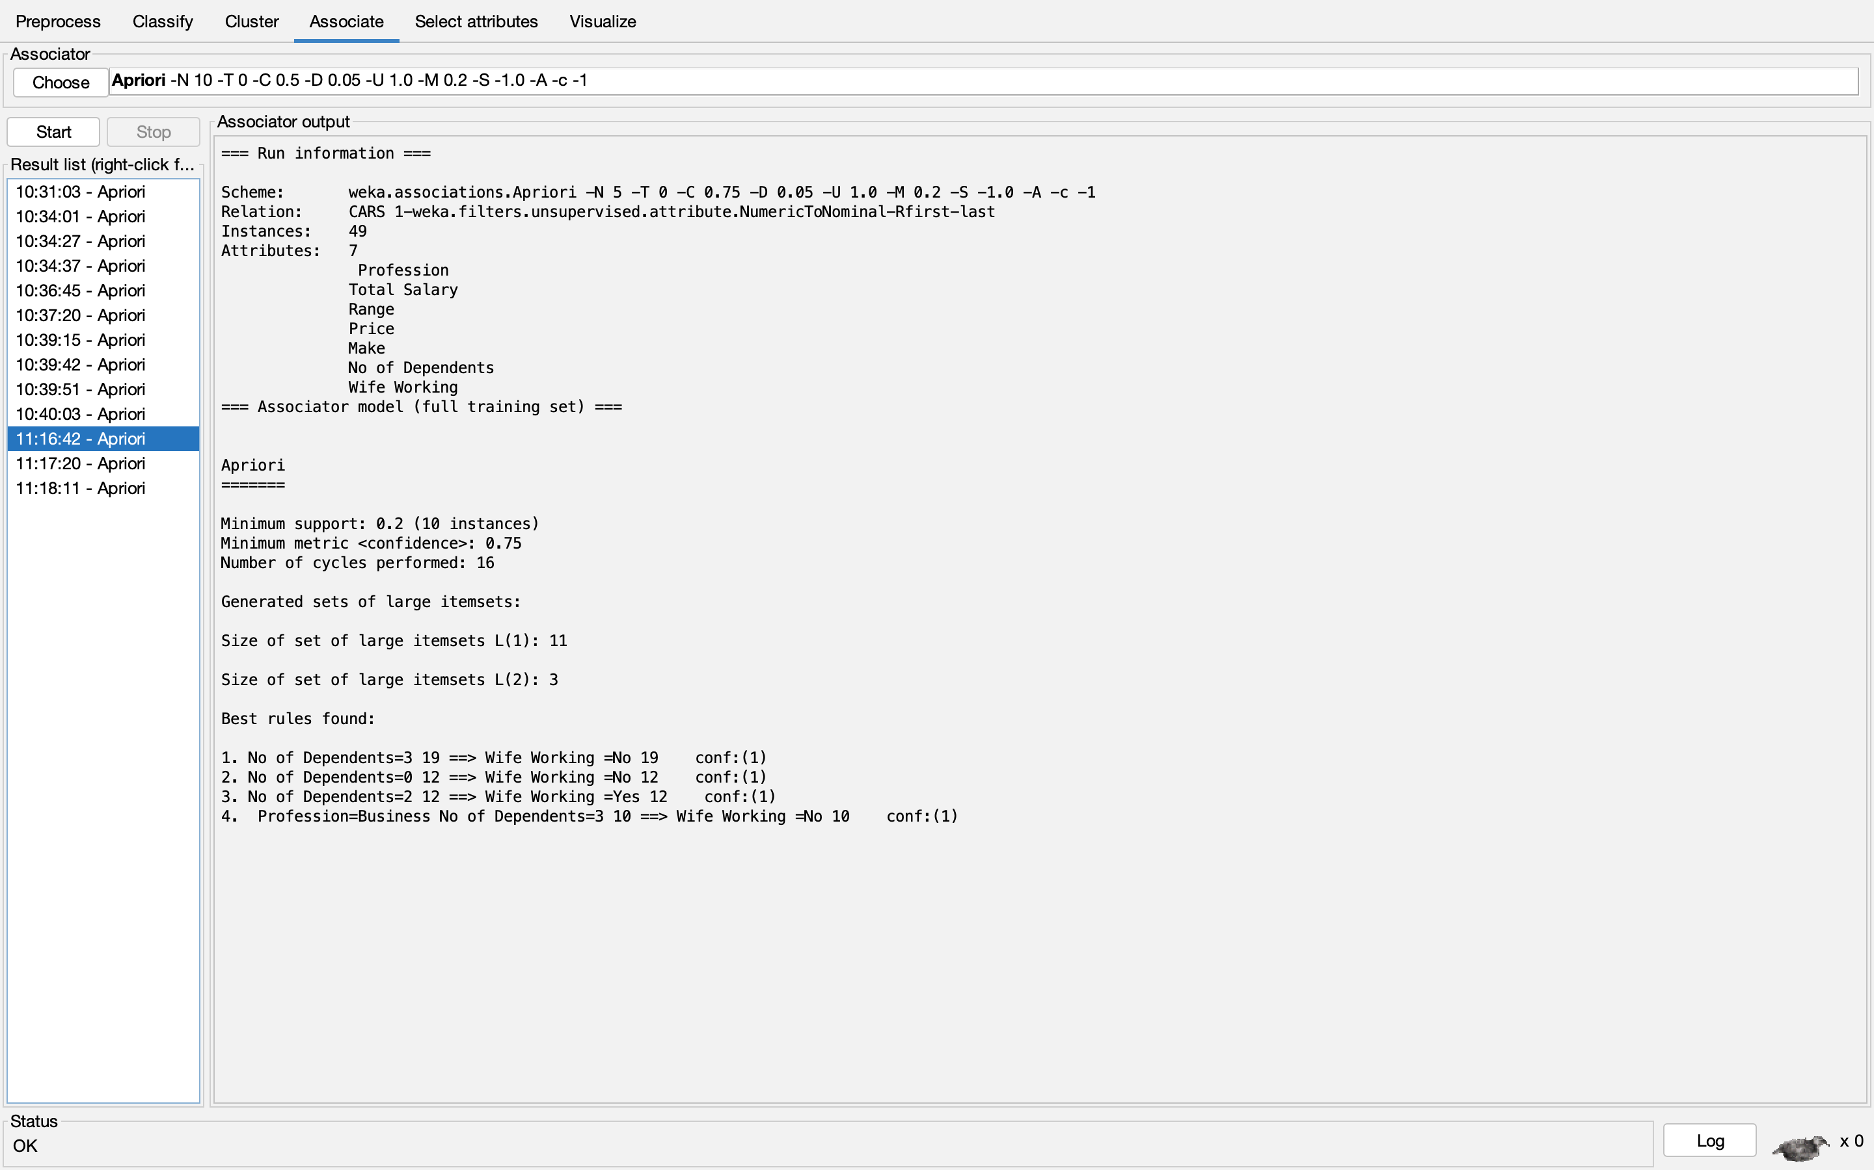
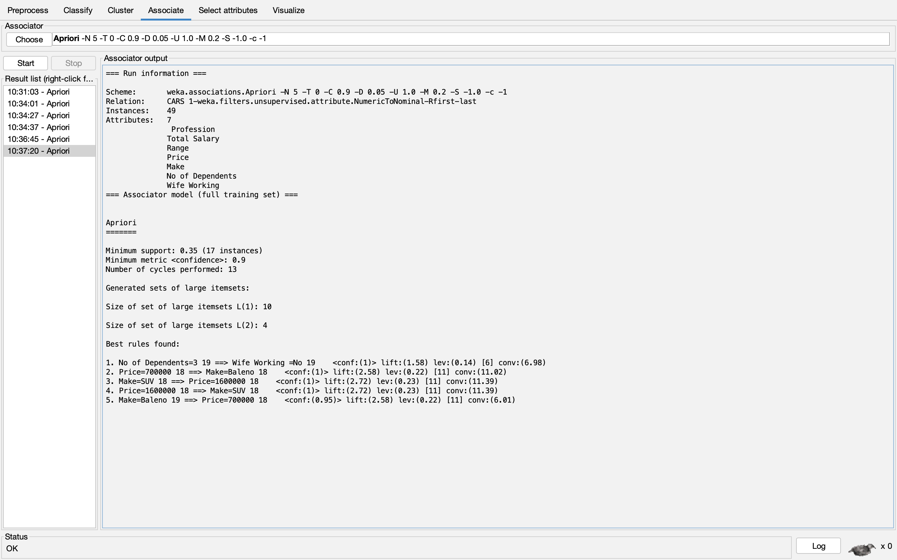
However, we have changed the Parmateres and adjusted the support and confidence thresholds each time.
We get different results

Slide 9
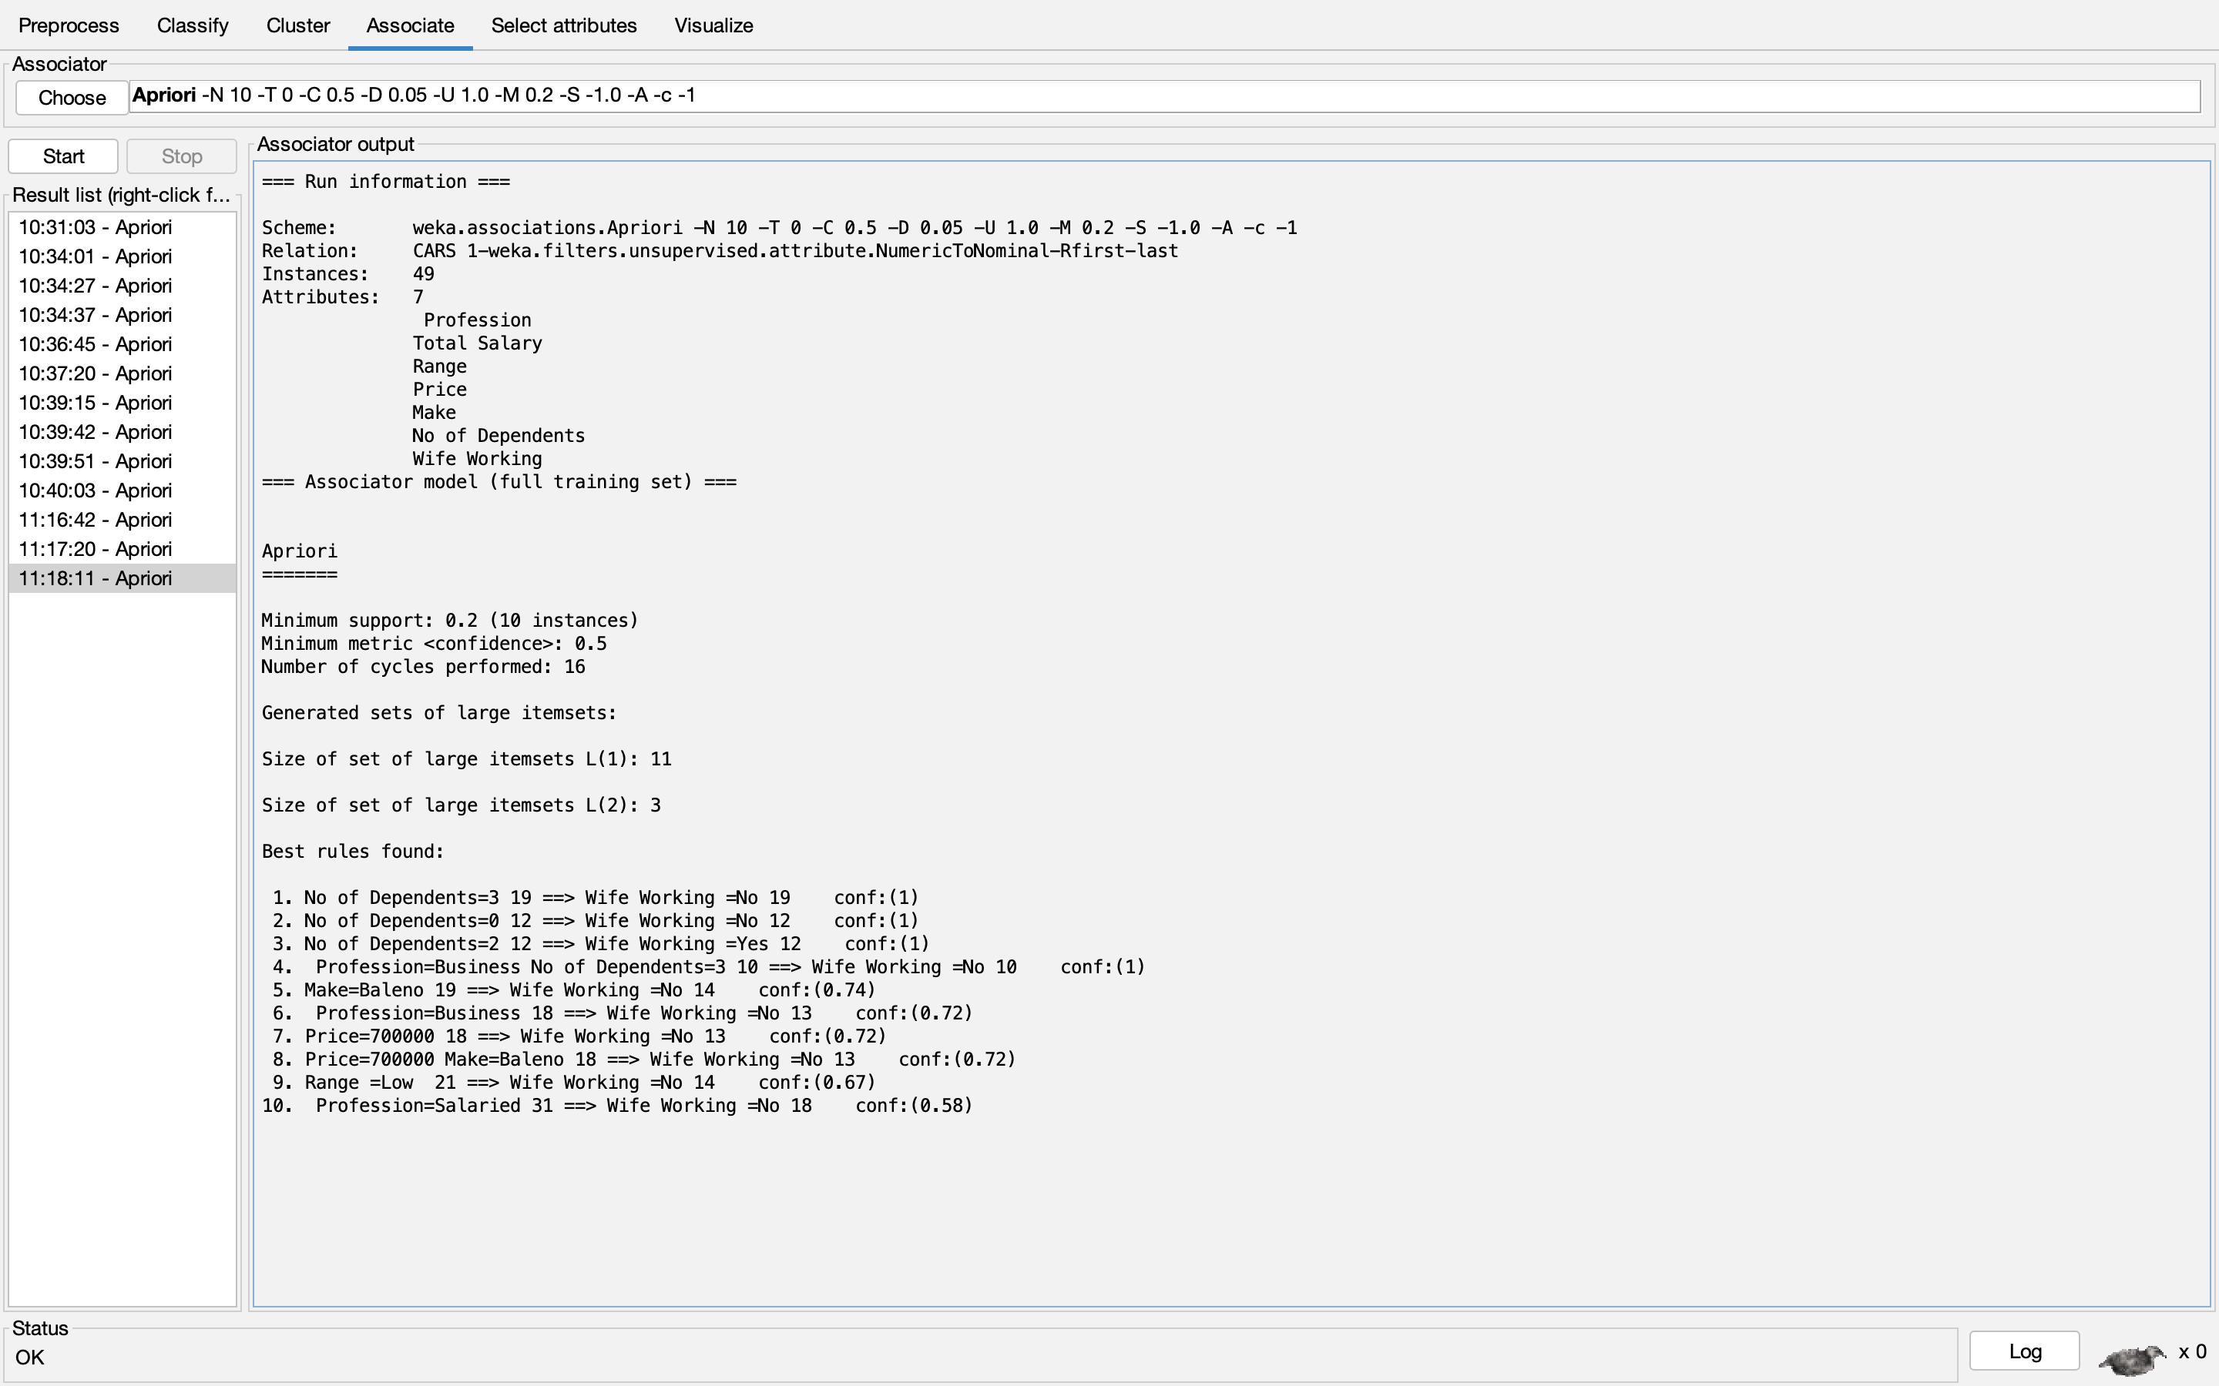

Slide 10
Results/Analysis
It has been observed that mostly in the house holds with 3 dependents ,the wife is not working.
Most customers’ are choosing to buy a baleno irrespective of their salary because of the wife working status.
Most customers range of buying is between 70-160 thousand dollars.
Customers with profession business are inclined to buy SUV’s with the price of 1700000

Slide 11
CONCLUSION
However to conclude, the objective was to increase sales in the dealer outlets. With the analysis and results obtained the company can make their sales and marketing strategies accordingly.
THANK YOU!

